Slide 1

Iris classification
Ebel Kasım yurt
Simar Madinayev
Muhammed Buğra Aydemir

Slide 2

Iris classification
The Iris Flower Dataset contains 50 samples distributed across three iris species (Iris Setosa, Iris Virginica, and Iris versicolor). Each of these examples has certain characteristics, and thanks to these characteristics, the examples can be divided into three categories. In this project, multilayer perceptron will be used to classify iris samples.
The dataset includes 50 samples each from three iris species (Iris setosa, Iris virginica, and Iris versicolor). Each specimen includes four features, such as the length and width (in centimeters) of sepals and petals.
developed a linear discriminant model to distinguish species from each other based on the combination of these four features.
The Iris dataset will be formatted and processed using the numpy, matplotlib, seaborn, and scikit-learn libraries.

Slide 3
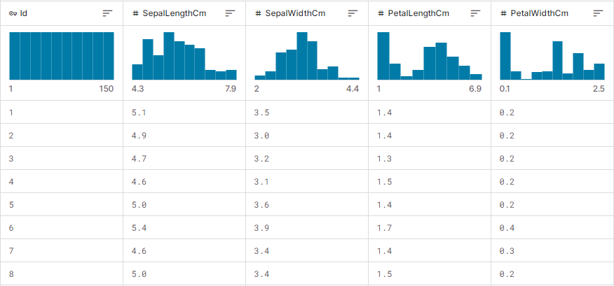
Iris classification
"iris_data" dataset was used while making this project.

Slide 4
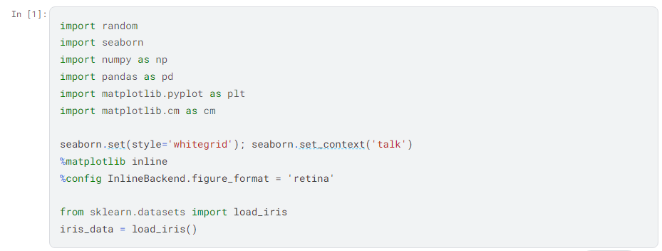
Iris classification
Libraries such as numpy, matplotlib, seaborn and scikit-learn were used to process the dataset, and Multilayer Perceptron was implemented using numpy for array operations.
Görsel alan

Slide 5
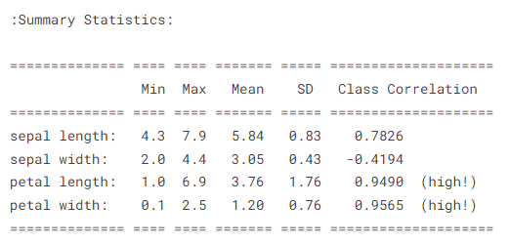
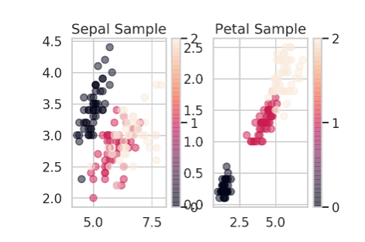
Iris classification

Slide 6
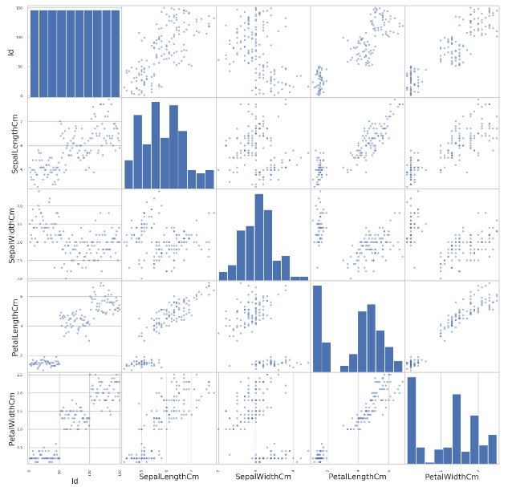
Iris classification

Slide 7
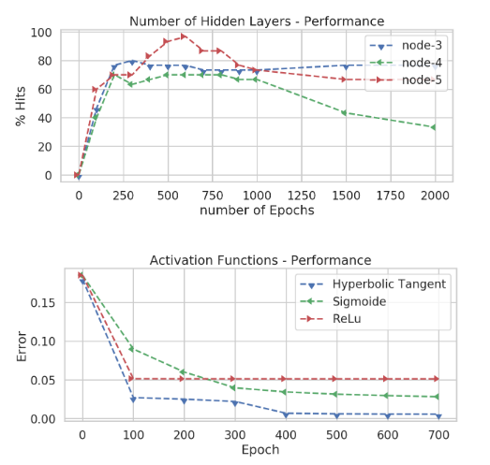
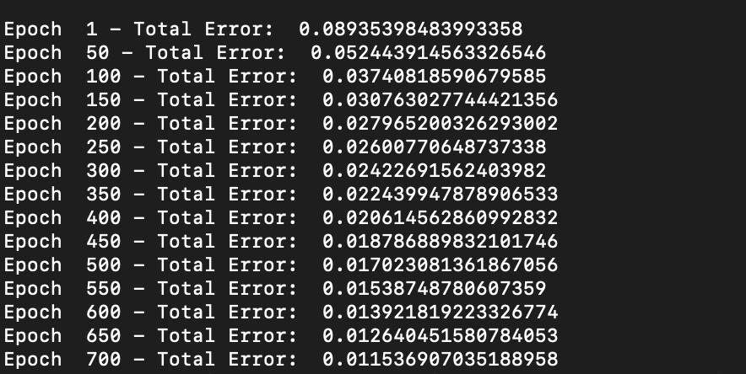
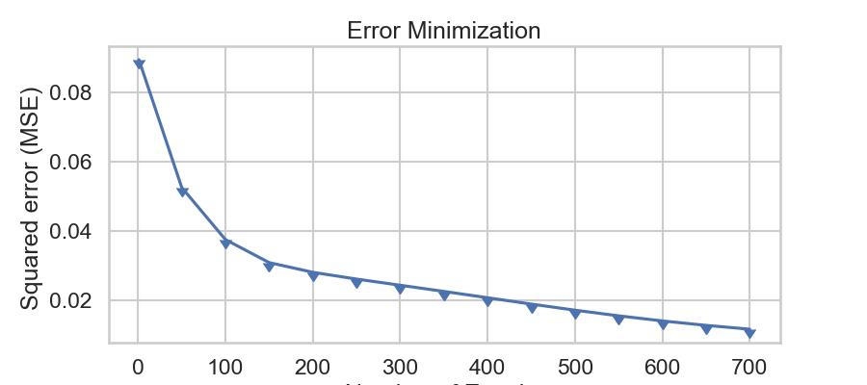
Iris classification

Slide 8
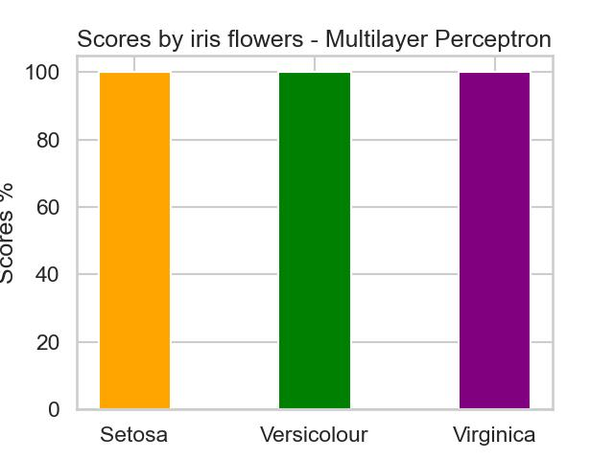
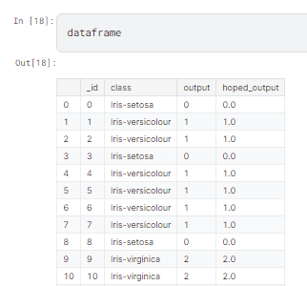

Iris classification

Slide 9
Iris Classification

